Slide 1
First Java Program:
Displaying things on the screen

Slide 2
Your first Java program with BlueJ
Open BlueJ and create a new project (Project > New Project)
Give your project a name
  All of your project files will be placed inside a folder with this name
Click “New Class”, and name it HelloWorld (without a space)
For now, think of a class as just a piece of Java source code

Slide 3
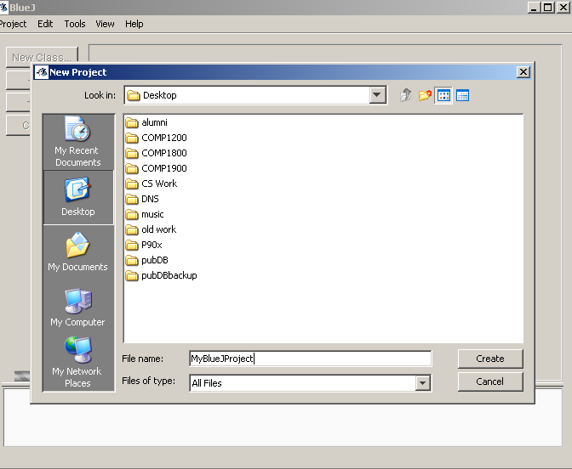
Name your BlueJ project
Choose where you want to save your BlueJ project

Slide 4
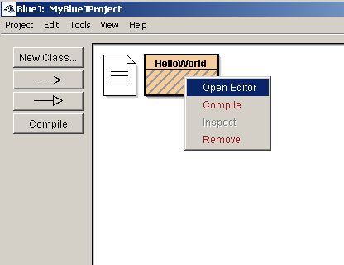
Your first Java program with BlueJ
Once the HelloWorld class has been created, right-click on it and select Open Editor

Slide 5
Your first Java program with BlueJ
BlueJ automatically generates some Java source code for you when you create a new class
  The code may not make sense to you yet – in due time, grasshopper, in due time
For now, just modify the code to look like this:
public class HelloWorld
{
public static void main(String[] args)
{
System.out.println(″Hello World!″);
}
}

Slide 6
Your first Java program with BlueJ
To run any Java program you’ve written in BlueJ, you need to do 2 things:
  COMPILE your source code – this produces Java bytecode
  RUN the compiled Java bytecode using the JVM
Every time you change something in your source code, you need to repeat these 2 steps to run the modified program

Slide 7
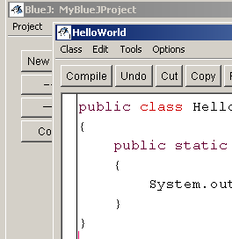
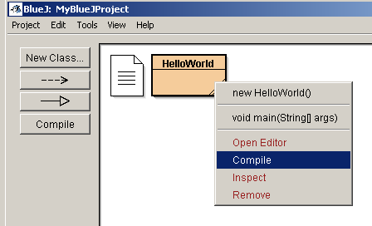
Compiling a Java program in BlueJ
Use the Compile button in the BlueJ editor
Right-click your class and select Compile from the menu
OR
If you get an error message, check that you’ve typed in the program exactly as shown on the slide – spelling, case, symbols, everything! You need to be very precise when programming in Java.

Slide 8
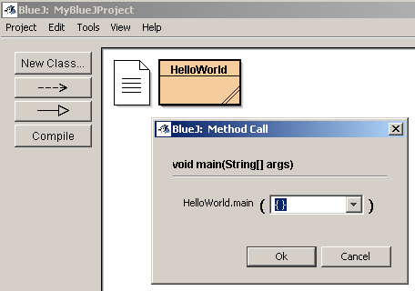
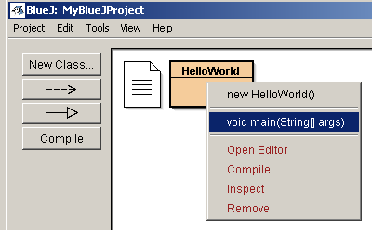
Running a Java program in BlueJ
Right-click your class and select
void main(String[] args)
from the menu
Then click OK on the box that pops up
You should see a new window that says Hello World!

Slide 9
What does all that source code mean?
public class HelloWorld
{
public static void main(String[] args)
{
System.out.println(″Hello World!″);
}
}
public class HelloWorld says “This is a program named HelloWorld”
Note the opening and closing curly braces { } – they signify that everything between them is the content of this program

Slide 10
What does all that source code mean?
public class HelloWorld
{
public static void main(String[] args)
{
System.out.println(″Hello World!″);
}
}
public static void main(String[] args) says “This is the main method of this program”
  A method is a section of your program that performs some task
  Programs can have many methods, but this one has only one (the main method)
  When you run your program, execution always starts from the main method
  Again, note the opening and closing curly braces { } – they signify that everything between them is the content of this main method

Slide 11
What does all that source code mean?
public class HelloWorld
{
public static void main(String[] args)
{
System.out.println(″Hello World!″);
}
}
System.out.println(″Hello World!″); says “Print out Hello World! on the screen, followed by a newline”
  This is the only statement, or instruction, in the main method
  Note the parentheses ( ) – they signify boundaries around the stuff that you want System.out.println to display
  The double quotes around Hello World! indicate that Hello World! is a string literal (or just string for short) – a sequence of characters. The double quotes indicate the beginning and end of the string. Notice that the double quotes don't appear when you run the program.
  All Java statements must end with a semicolon

Slide 12
What does all that source code mean?
public class HelloWorld
{
public static void main(String[] args)
{
System.out.println(″Hello World!″);
}
}
This indentation makes it clear what content is between the green curly braces
This indentation makes it clear what content is between the red curly braces
Indenting your source code like this is not strictly necessary (the Java compiler will work even if you don't indent), but it makes it much easier to read.

Slide 13
Program comments
Comments can be written anywhere in a program to clarify or explain what actions the program is taking
  For a very simple program like this, comments aren't really necessary
  But for more complex programs, comments are essential (both for yourself and for other programmers who might be reading your code)
  Comments are ignored by the Java compiler, so they can be written in plain English

Slide 14
Program comments
Two kinds of comments in Java:
  A single-line comment begins with two forward slashes //
  The compiler will ignore anything after the // only on that line
  A multi-line comment begins with /* and ends with */
  The compiler will ignore anything between those two symbols, regardless of how many lines of text there are

Slide 15
Program comments
Example: Hello World program with some comments (highlighted in green) added to it
/* This program simply displays the message
Hello World! on the screen.*/
public class HelloWorld // program name
{
// main method
public static void main(String[] args)
{
// println statement
System.out.println(″Hello World!″);
}
}

